Slide 1
Hidden Markov Models
Scott O’Hara
Metrowest Developers Machine Learning Group
05/23/2018

Slide 2
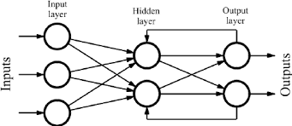
RNN Discussion Reminded Me of HMMs

Slide 3
HMM Data Flow
Choose Initial State
Choose Next State
Choose Final State
Choose Observation State

Slide 4
Contents:
Introducing Hidden Markov Models (HMMs)
Some Probability Preliminaries
HMM Algorithms
HMM Applications
Training HMMs: Baum-Welch
Maybe Next Time:
Computing Belief States
The Backward-Forward Algorithm
The Viterbi Algorithm
The Baum-Welch Algorithm

Slide 5
Introducing Hidden Markov Models
Markov Processes
Hidden Markov Models (HMM)
The Markov Assumptions
Notes:
Consider talking about:
Probability of an observed sequence
Probability of the latent variables
Statistical significance

Slide 6
Markov Process
A Markov process (or chain) is a stochastic model describing a sequence of possible events in which the probability of each event depends only on the state attained in the previous event.
Source: https://en.oxforddictionaries.com/definition/us/markov_chain
A Markov process has the following components:
A set of N states
A transition probability matrix representing the probability of moving from state i to state j. . For any state i, all probabilities must sum to 1.
A special start state and end state.
Source: adapted from https://web.stanford.edu/~jurafsky/slp3/9.pdf

Slide 7
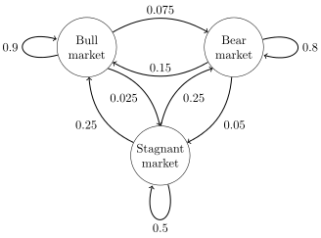
Markov Process Example
Source: https://upload.wikimedia.org/wikipedia/commons/4/47/MarkovChain1.png
A possible sequence of states:
Bull, Bull, Bull, Stagnant, Stagnant, Bull, Stagnant, Bear, Bear

Slide 8
Hidden Markov Models
A Hidden Markov Model (HMM) is a statistical model in which the system being modeled is assumed to be a Markov process with unobserved (i.e. hidden) states.
Source: https://en.wikipedia.org/wiki/Hidden_Markov_model
A Hidden Markov model has the following components:
A set of N states
An initial probability distribution over the states specifying the probability that state i is the first state in a sequence.
A transition probability matrix representing the probability of moving from state i to state j. . For any state i, all probabilities must sum to 1.
A sequence of observation states.
a sequence of observation likelihoods each expressing the probability of an observation i being generated from state i.
Source: adapted from https://web.stanford.edu/~jurafsky/slp3/9.pdf

Slide 9
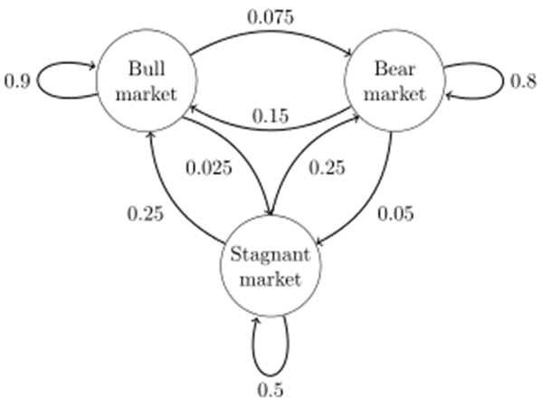
HMM Example (1)
States and Transitions:
States and Observations:
Bull
Stag
Bear
0.75
0.25
0.50
0.50
0.25
0.75
Dow
Up
Dow
Dn
Dow
Up
Dow
Dn
Dow
Up
Dow
Dn

Slide 10
HMM Example (2)
An Observation Sequence:
Bull
Bull
Bull
Stag
Stag
Bull
Stag
Bear
Bear
. . .
Dow
Up
Dow
Up
Dow
Up
Dow
Dn
Dow
Up
Dow
Up
Dow
Dn
Dow
Up
Dow
Dn
States and Transitions:
States and Observations:
Bull
Stag
Bear
0.75
0.25
0.50
0.50
0.25
0.75
Dow
Up
Dow
Dn
Dow
Up
Dow
Dn
Dow
Up
Dow
Dn

Slide 11
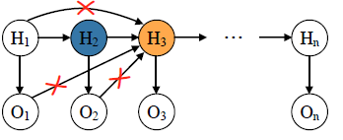
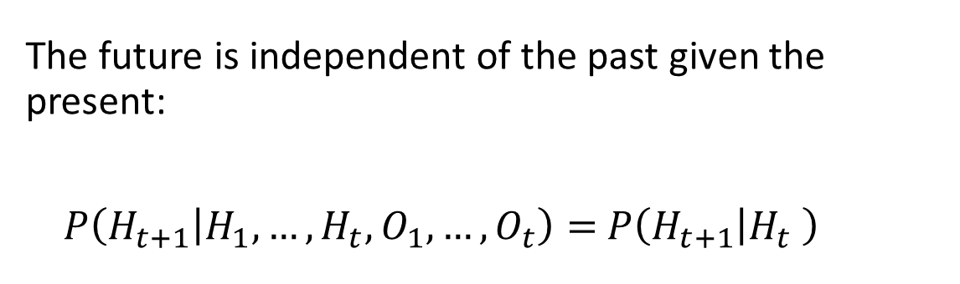
Markov Assumption 1
The future is independent of the past given the present:
$P\left(H_{t+1} | H_{1},…,H_{t},O_{1},…,O_{t}\right)=$ $P\left(H_{t+1} | H_{t} \right)$

Slide 12
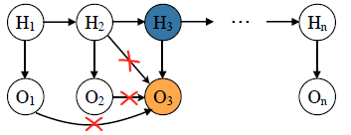
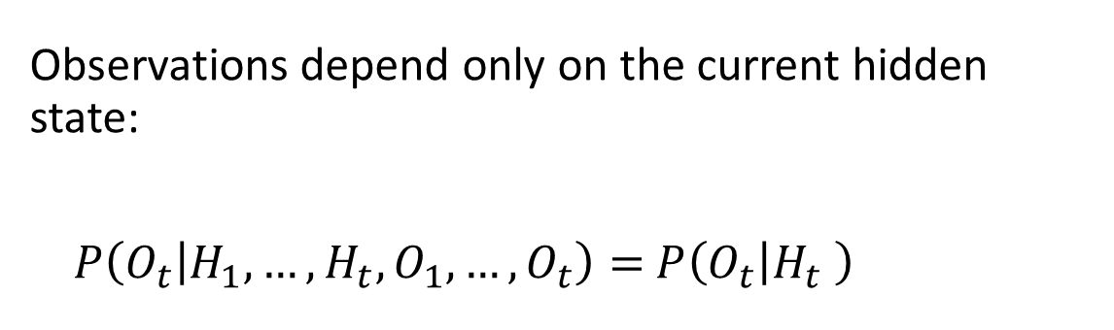
Markov Assumption 2
Observations depend only on the current hidden state:
$P\left(O_{t} | H_{1},…,H_{t},O_{1},…,O_{t}\right)=$ $P\left(O_{t} | H_{t} \right)$

Slide 13
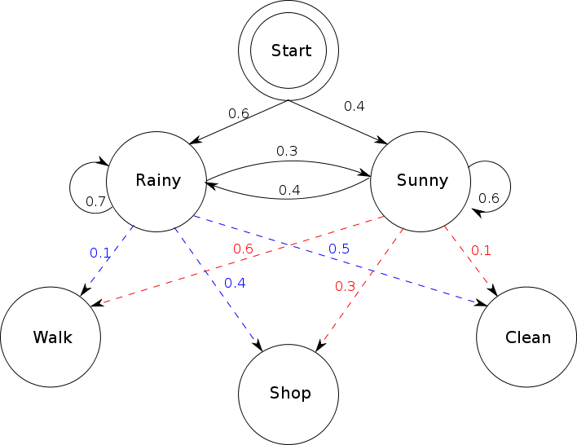
HMM Data Structures
# n = 2 hidden states
states = ('Rainy', 'Sunny’)
# m = 3 observation states
observations = ('walk', 'shop', 'clean’)
# n x 1 start table
start_probability = {'Rainy': 0.6, 'Sunny': 0.4}
# n x n transition table
transition_probability = { 'Rainy' : {'Rainy': 0.7, 'Sunny': 0.3},
'Sunny' : {'Rainy': 0.4, 'Sunny': 0.6}, }
# n x m observation table
emission_probability = { 'Rainy' : {'walk': 0.1, 'shop': 0.4, 'clean': 0.5},
'Sunny' : {'walk': 0.6, 'shop': 0.3, 'clean': 0.1}, }
By Terencehonles - Own work, Public Domain, https://commons.wikimedia.org/w/index.php?curid=8384168
Adapted from https://en.wikipedia.org/w/index.php?title=Hidden_Markov_model&oldid=841523243

Slide 14
Some Probability Preliminaries
Notes:
Consider talking about:
Probability of an observed sequence
Probability of the latent variables
Statistical significance

Slide 15
Some Probability Preliminaries
Discrete Random Variables
Probabilities and the Sum Rule
Joint Probability
Conditional Probability
The Product Rule
The Chain Rule
Bayes’ Rule
Marginalization

Slide 16
Discrete Random Variables
Discrete Variable – a variable that can only take on a finite number of values.
Random Variable - a variable whose possible values are outcomes of a random process.
Random variables are represented as bold-faced capital letters e.g., A or B.
For random variable X, the set of possible values it may take is represented by the lowercase X.
A Discrete Random Variable is a discrete variable whose possible values are outcomes of a random process.

Slide 17
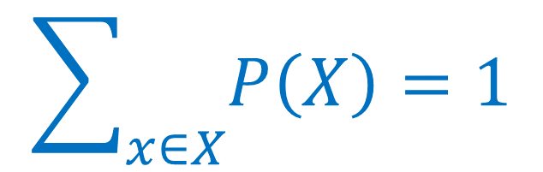
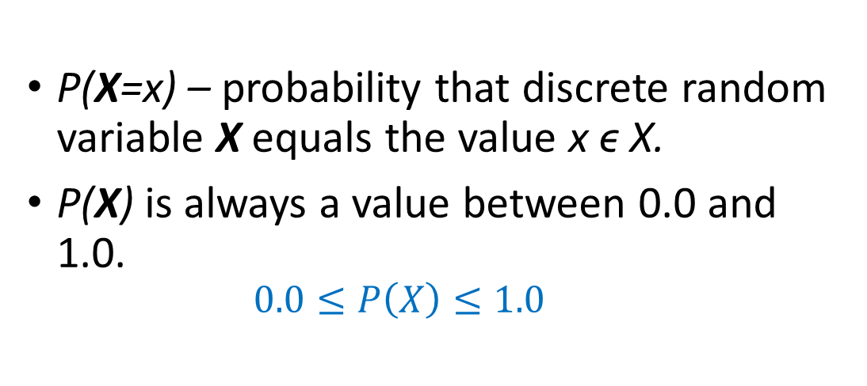
Probabilities and the Sum Rule
P(X=x) – probability that discrete random variable X equals the value x ϵ X.
P(X) is always a value between 0.0 and 1.0.
$$0.0≤P\left(X\right)≤1.0$$
$$\sum_{x∈X}{P\left(X\right)}=1$$

Slide 18
Joint Probability
World
P(a)
P(b)
Identities:
P(A,B) = P(B,A)
P(a,b)

Slide 19
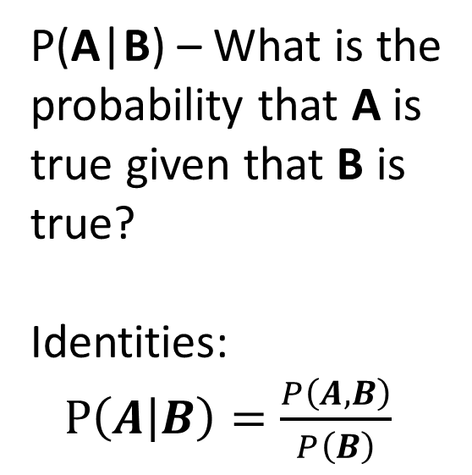
Conditional Probability
World
P(a)
P(b)
P(A|B) – What is the
probability that A is
true given that B is
true?
Identities:
$P\left(A | B\right)=\frac{P\left(A,B\right)}{P\left(B\right)}$
P(a|b)

Slide 20

The Product Rule
$P\left(A | B\right)=\frac{P\left(A,B\right)}{P\left(B\right)}$ Conditional Probability
$P\left(A,B\right)=$ $P\left(A | B\right)$ $P\left(B\right)=$ $P\left(B | A\right)$ $P\left(A\right)$

Slide 21

The Chain Rule (Generalized Product Rule)
$P\left(A,B\right)= P\left(A | B\right) P\left(B\right)$ Product Rule
$P\left(A_{1}, A_{2},…,A_{n}\right)=$ $P\left(A_{1} | A_{2},…,A_{n}\right)$ $P\left(A_{2},…,A_{n}\right)$

Slide 22

Chain Rule Example
$P\left(A_{1}, A_{2},…,A_{n}\right)= P\left(A_{1} | A_{2},…,A_{n}\right)P\left(A_{2},…,A_{n}\right)$ Chain Rule
Example:
$P\left(A_{1}, A_{2},A_{3}, A_{4}\right)=P\left(A_{1} | A_{2},A_{3}, A_{4}\right)P\left(A_{2},A_{3}, A_{4}\right)$
$=P\left(A_{1} | A_{2},A_{3}, A_{4}\right)P\left(A_{2} | A_{3}, A_{4}\right)P\left(A_{3}, A_{4}\right)$
$=P\left(A_{1} | A_{2},A_{3}, A_{4}\right)P\left(A_{2} | A_{3}, A_{4}\right)P\left(A_{3} | A_{4}\right)P\left(A_{4}\right)$

Slide 23
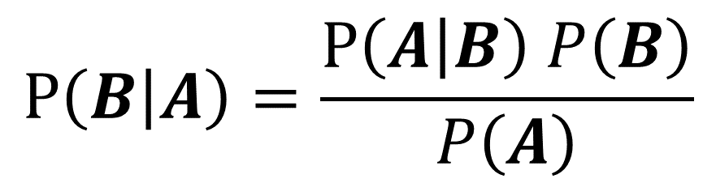

Bayes’ Rule
$P\left(A,B\right)=$ $P\left(A | B\right)$ $P\left(B\right)=$ $P\left(B | A\right)$ $P\left(A\right)$ Product Rule
$P\left(A | B\right)$ $P\left(B\right)=$ $P\left(B | A\right)$ $P\left(A\right)$
$P\left(B | A\right) P\left(A\right)=P\left(A | B\right)$ $P\left(B\right)$
$$P\left(B | A\right)=\frac{P\left(A | B\right) P\left(B\right)}{P\left(A\right)}$$

Slide 24
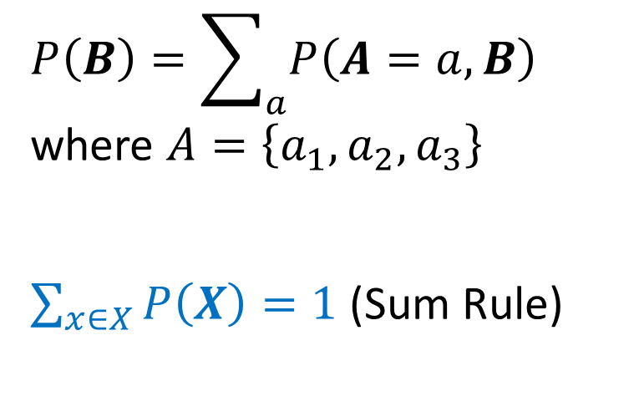
Marginalization
World
P(A=a₂)
P(A=a₁)
$$P\left(B\right)=\sum_{a}{P\left(A=a,B\right)}$$
where $A=\left\{a_{1},a_{2},a_{3}\right\}$
$\sum_{x∈X}{P\left(X\right)}=1$ (Sum Rule)
P(b)
P(b)
P(A=a₃)

Slide 25
HMM Algorithms
Notes:
Consider talking about:
Probability of an observed sequence
Probability of the latent variables
Statistical significance

Slide 26
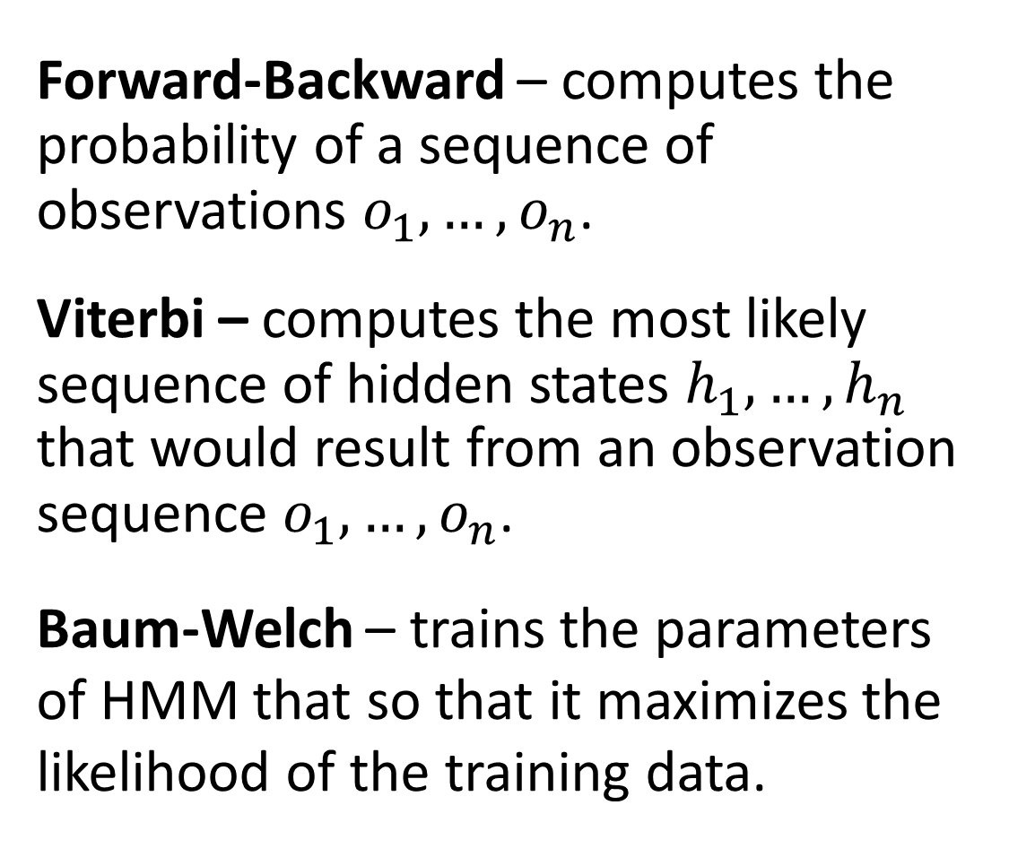
The 3 HMM Algorithms
Forward-Backward – computes the probability of a sequence of observations $o_{1},…,o_{n}$.
Viterbi – computes the most likely sequence of hidden states $h_{1},…,h_{n}$ that would result from an observation sequence $o_{1},…,o_{n}$.
Baum-Welch – trains the parameters of HMM that so that it maximizes the likelihood of the training data.

Slide 27

The Forward-Backward Algorithm
Given an HMM, the forward-backward algorithm takes as input an observation sequence $o_{1},…,o_{n}$, and computes $P\left(o_{1},…,o_{n}\right)$, i.e., the probability that the sequence would be generated by the HMM model.
Uses a dynamic programming approach, which is possible because of the Markov assumptions.
Relatively efficient at $O\left(m^{2}n\right)$ where m is the number of hidden states and n is the sequence length.
Forms the basis for sequence classification.
There are 2 forms: the forward algorithm and the backward algorithm. There is no advantage of one over the other.

Slide 28

The Viterbi Algorithm
Given an HMM, the Viterbi algorithm computes the most likely sequence of hidden states $h_{1},…,h_{n}$ that would result in a given observation sequence $o_{1},…,o_{n}$
Uses a dynamic programming approach
Similar to the Forward-Backward algorithm but has both a forward and backward pass.
$O\left(m^{2}n\right)$ where m is the number of hidden states and n is the sequence length.
Used to find the “best explanation” for a given observation sequence.

Slide 29
The Baum-Welch Algorithm
Given a set of observation sequences (training data) and the number of hidden states m, train the parameters of an m-state HMM that maximizes the likelihood of the training data.
The parameter include the probabilities in the start table, the transition table and the observation table.
The algorithm is a hill-climbing algorithm and is an application of the more general expectation-maximization algorithm.
Uses Forward-Backward algorithm

Slide 30

Baum-Welch Algorithm Cost
m hidden states
N training sequences
n max length per sequence
$O\left(m^{2}Nn\right)$
How many iterations are needed? Unknown

Slide 31
Some HMM Variants
There are many HMM variants
N-order HMMs – HMM depends on n previous states.
Input/Output HMMs – adds a visible input node I_{t} at each time t. Each hidden node and observation node at time t receives an input from I_{t}.
Factorial HMMs – allow multiple chains of hidden nodes. Does not satisfy Markov property.
Switching Auto-Regressive HMMs (SAR-HMMs) – Use real-valued observations that are correlated to previous observations by linear regression.
Kalman Filter – HMM cousin where hidden states are continuous real values as are the observations.
Etc., etc.

Slide 32
HMM Applications
Notes:
Consider talking about:
Probability of an observed sequence
Probability of the latent variables
Statistical significance

Slide 33

What Problems HMMs Can Solve
Filtering – given a sequence of observations $o_{1},…,o_{t}$, find the most likely state $h_{t}$ i.e., where $P\left(h_{t} | o_{1},…,o_{t}\right)$ is maximal.
Smoothing – given a sequence of observations $o_{1},…,o_{T}$ and $t<T$, find the most likely state $h_{t}$ i.e., where $P\left(h_{t} | o_{1},…,o_{T}\right)$ is maximal.
Prediction – given a sequence of observations $o_{1},…,o_{t}$, predict the most likely observation $o_{t+1}$ i.e., where $P\left(o_{t+1} | o_{1},…,o_{t}\right)$ is maximal.
Classification – classify a sequence of observations $o_{1},…,o_{t}$ by assigning a class c associated with the HMM_{c} that computes the highest probability of generating the sequence.
Explanation – Given a a sequence of observations $o_{1},…,o_{t}$, find a sequence of hidden states $h_{1},…,h_{t}$ that best explains the observations.

Slide 34
Some Real HMM Application Areas
Computational Finance
Speech Recognition e.g., Siri
Speech Synthesis
Part-of-Speech Tagging
Protein Folding
Single-molecule kinetic analysis
Target tracking (Kalman filter)
etc., etc.
Sources:
“The Master Algorithm: How the Quest for the Ultimate Learning Machine Will Remake Our World”, Pedro Domingos, 2015.
https://en.wikipedia.org/wiki/Hidden_Markov_model

Slide 35
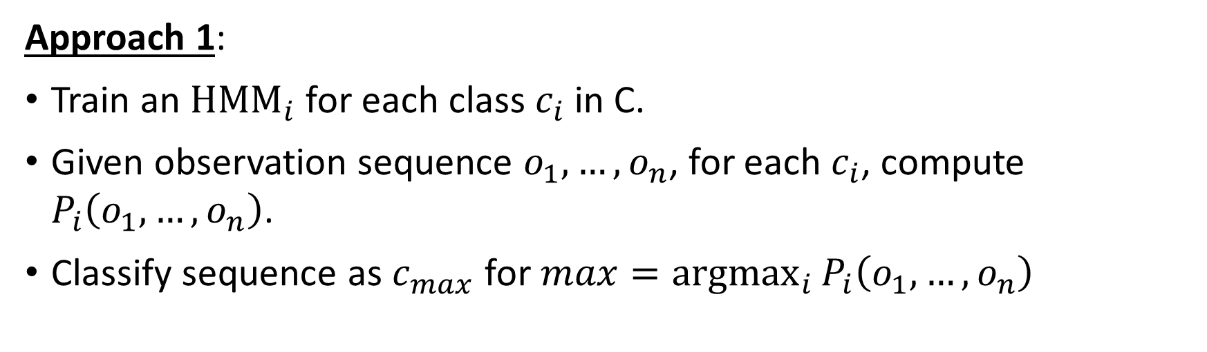
Classifying an Observation Sequence
Approach 1:
Train an ${\text{HMM}}_{i}$ for each class $c_{i}$ in C.
Given observation sequence $o_{1},…,o_{n}$, for each $c_{i}$, compute $P_{i}\left(o_{1},…,o_{n}\right)$.
Classify sequence as $c_{max}$ for $max=\underset{i}{argmax}{P_{i}\left(o_{1},…,o_{n}\right)}$
Credit: adapted from lecture slides Sarah Finney, “CS181: Intelligent Machines Perception, Learning and Uncertainty”, 2009, Harvard University.

Slide 36

Classifying an Observation Sequence
Approach 2: Weight probabilities by prior probabilities for each class.
Compute prior probability $P\left(c_{i}\right)$ for each class $c_{i}$ in C.
Train an ${\text{HMM}}_{i}$ for each class $c_{i}$ in C.
Given observation sequence $o_{1},…,o_{n}$, compute $\underset{i}{argmax}{P\left(c_{i} | o_{1},…,o_{n}\right)}$.
$\underset{i}{argmax}{P\left(c_{i} | o_{1},…,o_{n}\right)}=\underset{i}{argmax}{\frac{P\left(o_{1},…,o_{n} | c_{i}\right)P\left(c_{i}\right)}{P\left(o_{1},…,o_{n}\right)}}$ (by Bayes’ rule)
$=\underset{i}{argmax}{P\left(o_{1},…,o_{n} | c_{i}\right)P\left(c_{i}\right)}$ ($o_{1},…,o_{n}$ has no
effect on max)
Classify sequence as $c_{max}$ for $\text{max}=\underset{i}{argmax}{P\left(o_{1},…,o_{n} | c_{i}\right)P\left(c_{i}\right)}$.
Credit: adapted from lecture slides Sarah Finney, “CS181: Intelligent Machines Perception, Learning and Uncertainty”, 2009, Harvard University.

Slide 37
Application Example: Word Recognition
Train a separate HMM for each word.
Represent a word as a sequence of phonemes (hidden states)
Represent observations as frequency vectors.

Slide 38
Application Example: Word Recognition (2)
A Word Model:
start
t
ae
bl
stop
An Observation Sequence:
Phoneme:
t
ae
ae
bl
. . .
Sound:
“t”
“ay”
“ay”
“bul”

Slide 39
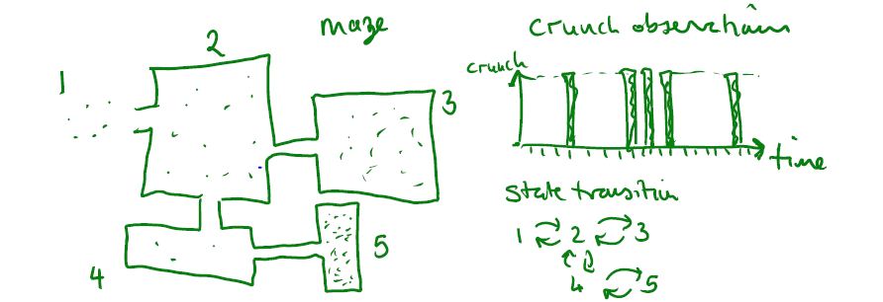
Application Example: Tracking
Suppose we want to track the movement of a mouse in a set of connected rooms.
There are microphones in each room that can detect various sounds like: “squeak”, “scurry”, “crunch”.
The microphones don’t always pick up a sound and may detect sounds in other rooms.
Use filtering, smoothing and prediction to estimate where the mouse is, what it is doing and where it will go next.
Credit: adapted from course notes, Avi Pfeffer; Revised by David Parkes, “CS181: Intelligent Machines Perception, Learning and Uncertainty”, 2011, Harvard University.

Slide 40
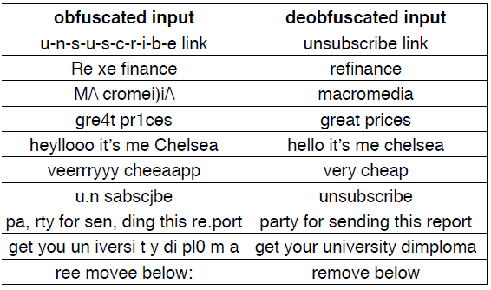
Application Example: Spam “Deobfuscation”
Credit: adapted from lecture slides Sarah Finney, “CS181: Intelligent Machines Perception, Learning and Uncertainty”, 2009, Harvard University.

Slide 41
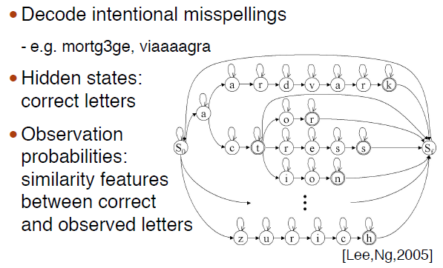





Application Example: Spam “Deobfuscation”
Credit: adapted from lecture slides Sarah Finney, “CS181: Intelligent Machines Perception, Learning and Uncertainty”, 2009, Harvard University.

Slide 42
Training HMMs: Baum-Welch
Notes:
Consider talking about:
Probability of an observed sequence
Probability of the latent variables
Statistical significance

Slide 43
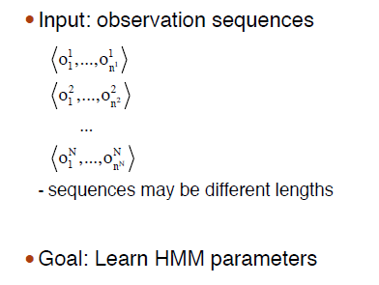
Learning Parameters
Credit: adapted from lecture slides Sarah Finney, “CS181: Intelligent Machines Perception, Learning and Uncertainty”, 2009, Harvard University.

Slide 44
HMM Data Structures
# n = 2 hidden states
states = ('Rainy', 'Sunny’)
# m = 3 observation states
observations = ('walk', 'shop', 'clean’)
# n x 1 start table
start_probability = {'Rainy': 0.6, 'Sunny': 0.4}
# n x n transition table
transition_probability = { 'Rainy' : {'Rainy': 0.7, 'Sunny': 0.3},
'Sunny' : {'Rainy': 0.4, 'Sunny': 0.6}, }
# n x m observation table
emission_probability = { 'Rainy' : {'walk': 0.1, 'shop': 0.4, 'clean': 0.5},
'Sunny' : {'walk': 0.6, 'shop': 0.3, 'clean': 0.1}, }
By Terencehonles - Own work, Public Domain, https://commons.wikimedia.org/w/index.php?curid=8384168
Adapted from https://en.wikipedia.org/w/index.php?title=Hidden_Markov_model&oldid=841523243

Slide 45
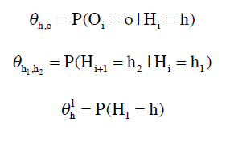
Parameters
Observation Table
Transition Table
Start Table
Credit: adapted from lecture slides Sarah Finney, “CS181: Intelligent Machines Perception, Learning and Uncertainty”, 2009, Harvard University.

Slide 46
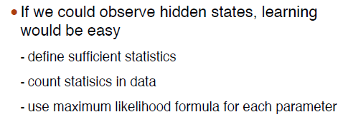
If only …
Credit: adapted from lecture slides Sarah Finney, “CS181: Intelligent Machines Perception, Learning and Uncertainty”, 2009, Harvard University.

Slide 47
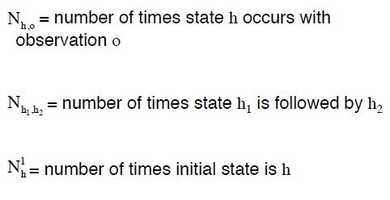
Sufficient Statistics
Credit: adapted from lecture slides Sarah Finney, “CS181: Intelligent Machines Perception, Learning and Uncertainty”, 2009, Harvard University.

Slide 48
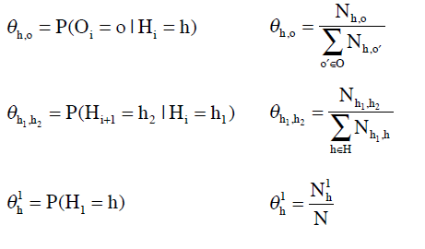
Maximum Likelihood Estimation
Credit: adapted from lecture slides Sarah Finney, “CS181: Intelligent Machines Perception, Learning and Uncertainty”, 2009, Harvard University.

Slide 49
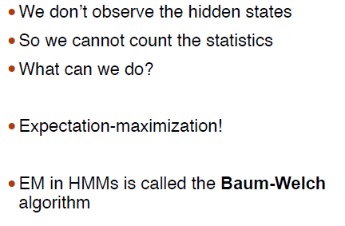
Unfortunately . . .
Credit: adapted from lecture slides Sarah Finney, “CS181: Intelligent Machines Perception, Learning and Uncertainty”, 2009, Harvard University.

Slide 50
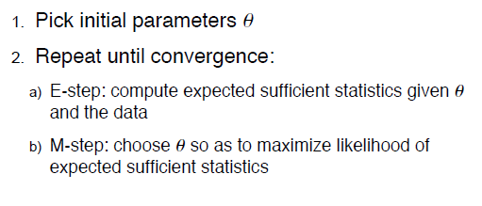
EM
Credit: adapted from lecture slides Sarah Finney, “CS181: Intelligent Machines Perception, Learning and Uncertainty”, 2009, Harvard University.

Slide 51
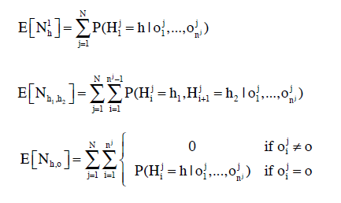
Expectation Step
Credit: adapted from lecture slides Sarah Finney, “CS181: Intelligent Machines Perception, Learning and Uncertainty”, 2009, Harvard University.

Slide 52
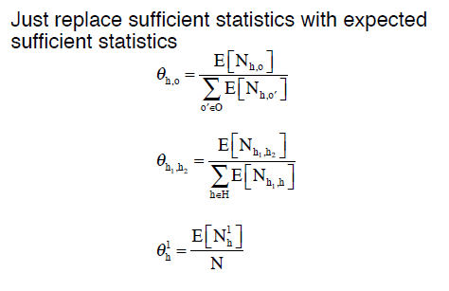
Maximization Step
Credit: adapted from lecture slides Sarah Finney, “CS181: Intelligent Machines Perception, Learning and Uncertainty”, 2009, Harvard University.

Slide 53
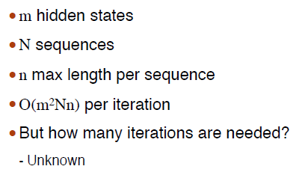
Cost
Credit: adapted from lecture slides Sarah Finney, “CS181: Intelligent Machines Perception, Learning and Uncertainty”, 2009, Harvard University.

Slide 54
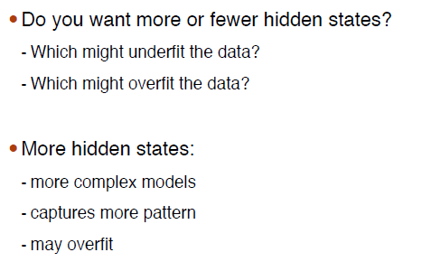
How Many Hidden States?
Credit: adapted from lecture slides Sarah Finney, “CS181: Intelligent Machines Perception, Learning and Uncertainty”, 2009, Harvard University.

Slide 55
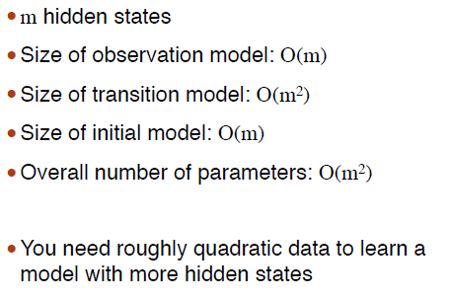
Amount of Data Needed
Credit: adapted from lecture slides Sarah Finney, “CS181: Intelligent Machines Perception, Learning and Uncertainty”, 2009, Harvard University.

Slide 56
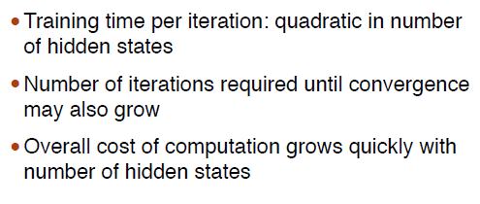
Training Time
Credit: adapted from lecture slides Sarah Finney, “CS181: Intelligent Machines Perception, Learning and Uncertainty”, 2009, Harvard University.

Slide 57
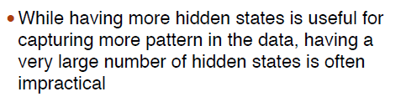
Bottom Line
Credit: adapted from lecture slides Sarah Finney, “CS181: Intelligent Machines Perception, Learning and Uncertainty”, 2009, Harvard University.

Slide 58
HMMs vs RNNs
Look in the slide notes below for topics to consider talking about
Notes:
Consider talking about:
Probability of an observed sequence
Probability of the latent variables
Statistical significance

Slide 59
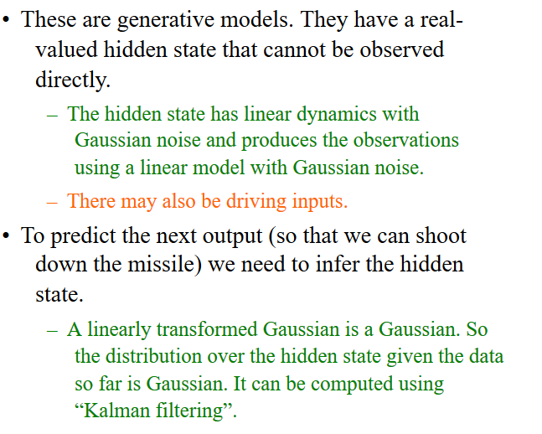
Linear Dynamical Systems (engineers love them!)
Credit: Geoffrey Hinton, https://www.cs.toronto.edu/~hinton/csc2535/notes/lec10new.pdf

Slide 60
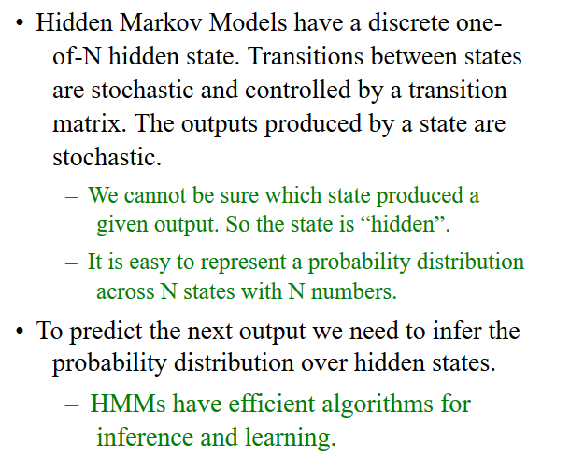
Hidden Markov Models (computer scientists love them!
Credit: Geoffrey Hinton, https://www.cs.toronto.edu/~hinton/csc2535/notes/lec10new.pdf

Slide 61
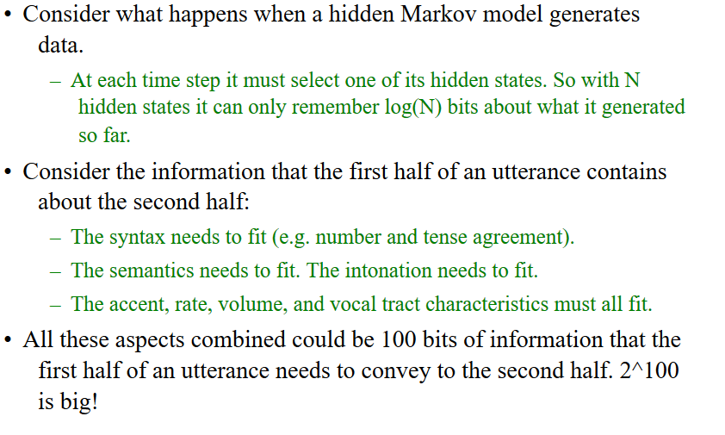
A fundamental limitation of HMMs
Credit: Geoffrey Hinton, https://www.cs.toronto.edu/~hinton/csc2535/notes/lec10new.pdf

Slide 62
A fundamental limitation of HMMs
Credit: Geoffrey Hinton, https://www.cs.toronto.edu/~hinton/csc2535/notes/lec10new.pdf

Slide 63
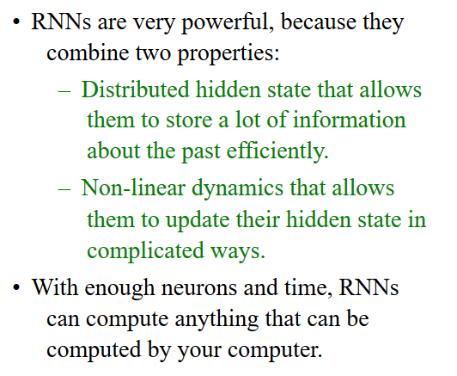
Recurrent neural networks
Credit: Geoffrey Hinton, https://www.cs.toronto.edu/~hinton/csc2535/notes/lec10new.pdf

Slide 64
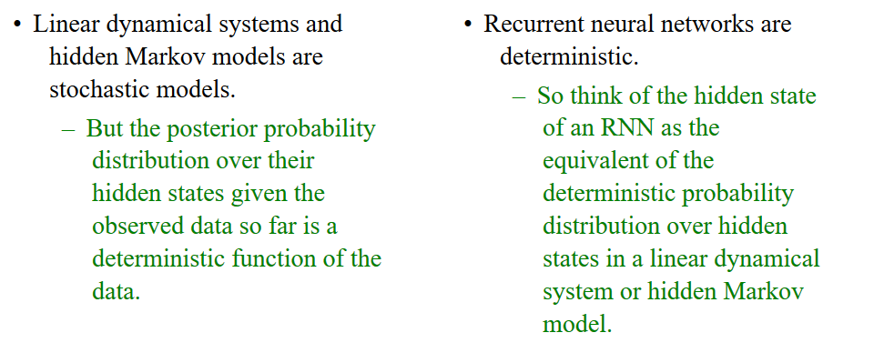
Do generative models need to be stochastic?
Credit: Geoffrey Hinton, https://www.cs.toronto.edu/~hinton/csc2535/notes/lec10new.pdf

Slide 65
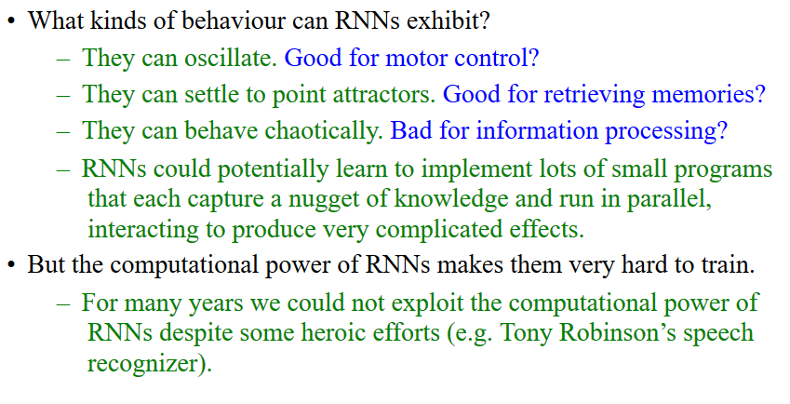
Recurrent neural networks
Credit: Geoffrey Hinton, https://www.cs.toronto.edu/~hinton/csc2535/notes/lec10new.pdf

Slide 66
Hidden Markov Models
Scott O’Hara
Metrowest Developers Machine Learning Group
05/23/2018

Slide 67
Extra Slides
Look in the slide notes below for topics to consider talking about
Notes:
Consider talking about:
Probability of an observed sequence
Probability of the latent variables
Statistical significance

Slide 68
Forward-Backward Algorithm
Given an HMM, compute the probability of an observation sequence.
Notes:
Consider talking about:
Probability of an observed sequence
Probability of the latent variables
Statistical significance

Slide 69
Compute the probability of a sequence of observations
Given: o₁, …, o_{n}
Goal: compute probability P(o₁, …, o_{n})
Two Algorithms:
Backward Algorithm
Forward Algorithm
Together called the forward-backward algorithm
Credit: adapted from lecture slides Sarah Finney, “CS181: Intelligent Machines Perception, Learning and Uncertainty”, 2009, Harvard University.

Slide 70

Approach 1: Enumerate All Possibilities
Introduce $h_{1},…,h_{n}$ with marginalization:
$$P\left(o_{1},…,o_{n}\right)=\sum_{h_{1},…,h_{n}}{P\left({h_{1},…,h_{n},o}_{1},…,o_{n}\right)}$$
Enumerate all possible configurations of $h_{1},…,h_{n}$ and sum the results where:
$$P\left({h_{1},…,h_{n},o}_{1},…,o_{n}\right)=P\left(o_{1} | h_{1}\right)P\left(h_{1}\right)\prod_{i=2}^{n}{P\left(h_{i} | h_{i−1}\right)P\left(o_{i} | h_{i}\right)}$$
Problem: the total number of sequences is exponential in the length of sequence.
Credit: adapted from lecture slides Sarah Finney, “CS181: Intelligent Machines Perception, Learning and Uncertainty”, 2009, Harvard University.

Slide 71
Approach 2: Dynamic Programming
Build the solution from the bottom up by combining the solution of smaller problems into the solution of larger problems.
Backward Algorithm: compute from the end of the sequence toward the beginning.
Forward Algorithm: computer from the beginning of the sequence toward the end.
Neither approach has any particular advantage.
Credit: adapted from lecture slides Sarah Finney, “CS181: Intelligent Machines Perception, Learning and Uncertainty”, 2009, Harvard University.

Slide 72
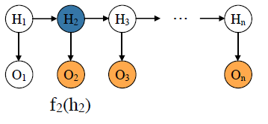
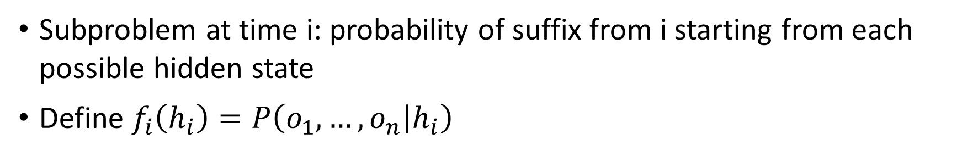
Backward Algorithm
Subproblem at time i: probability of suffix from i starting from each possible hidden state
Define $f_{i}\left(h_{i}\right)=P\left(o_{1},…,o_{n} | h_{i}\right)$
Credit: adapted from lecture slides Sarah Finney, “CS181: Intelligent Machines Perception, Learning and Uncertainty”, 2009, Harvard University.

Slide 73


Base Case
$f_{n}\left(h_{n}\right)=P\left(o_{n} | h_{n}\right)$, from the observation model.
Credit: adapted from lecture slides Sarah Finney, “CS181: Intelligent Machines Perception, Learning and Uncertainty”, 2009, Harvard University.

Slide 74

Backward Inductive Step
$$f_{i}\left(h_{i}\right)=P\left(o_{i},…,o_{n} | h_{i}\right)$$
$=P\left(o_{i} | h_{i}\right)P\left(o_{i+1},…,o_{n} | h_{i},o_{i}\right)$ chain rule
$=P\left(o_{i} | h_{i}\right)P\left(o_{i+1},…,o_{n} | h_{i} \right)$ Markov property
$=P\left(o_{i} | h_{i}\right)\sum_{h_{i+1}ϵ H}{P\left(h_{i+1},o_{i+1},…,o_{n} | h_{i} \right)}$ marginalization
$=P\left(o_{i} | h_{i}\right)\sum_{h_{i+1}ϵ H}{P\left(h_{i+1} | h_{i} \right)P\left(o_{i+1},…,o_{n} | h_{i},h_{i+1}\right)}$ chain rule
$=P\left(o_{i} | h_{i}\right)\sum_{h_{i+1}ϵ H}{P\left(h_{i+1} | h_{i} \right)P\left(o_{i+1},…,o_{n} | h_{i+1}\right)}$ Markov property
$=P\left(o_{i} | h_{i}\right)\sum_{h_{i+1}ϵ H}{P\left(h_{i+1} | h_{i} \right)f_{i+1}\left(h_{i+1}\right)}$ definition of f
Credit: adapted from lecture slides Sarah Finney, “CS181: Intelligent Machines Perception, Learning and Uncertainty”, 2009, Harvard University.

Slide 75


Inductive Step (1)
$$f_{i}\left(h_{i}\right)=P\left(o_{i} | h_{i}\right)\sum_{h_{i+1}ϵ H}{P\left(h_{i+1} | h_{i} \right)f_{i+1}\left(h_{i+1}\right)}$$
Previously
Computed
Credit: adapted from lecture slides Sarah Finney, “CS181: Intelligent Machines Perception, Learning and Uncertainty”, 2009, Harvard University.

Slide 76


Inductive Step (2)
$$f_{i}\left(h_{i}\right)=P\left(o_{i} | h_{i}\right)\sum_{h_{i+1}ϵ H}{P\left(h_{i+1} | h_{i} \right)f_{i+1}\left(h_{i+1}\right)}$$
from
transition
model
Credit: adapted from lecture slides Sarah Finney, “CS181: Intelligent Machines Perception, Learning and Uncertainty”, 2009, Harvard University.

Slide 77


Inductive Step (3)
$$f_{i}\left(h_{i}\right)=P\left(o_{i} | h_{i}\right)\sum_{h_{i+1}ϵ H}{P\left(h_{i+1} | h_{i} \right)f_{i+1}\left(h_{i+1}\right)}$$
from
observation
model
Credit: adapted from lecture slides Sarah Finney, “CS181: Intelligent Machines Perception, Learning and Uncertainty”, 2009, Harvard University.

Slide 78



Final Step (1)
$$P\left(o_{1},…,o_{n}\right)=\sum_{h_{1}∈H}{P\left(o_{1} | h_{1}\right)P\left(o_{2},…,o_{n} | h_{1} \right)}$$
$$=\sum_{h_{1}∈H}{P\left(o_{1} | h_{1}\right)f_{1}\left(h_{1}\right)}$$
Credit: adapted from lecture slides Sarah Finney, “CS181: Intelligent Machines Perception, Learning and Uncertainty”, 2009, Harvard University.

Slide 79


Final Step (2)
$$P\left(o_{1},…,o_{n}\right)=\sum_{h_{1}∈H}{P\left(o_{1} | h_{1}\right)P\left(o_{2},…,o_{n} | h_{1} \right)}$$
$$=\sum_{h_{1}∈H}{P\left(o_{1} | h_{1}\right)f_{1}\left(h_{1}\right)}$$
observation
model
Credit: adapted from lecture slides Sarah Finney, “CS181: Intelligent Machines Perception, Learning and Uncertainty”, 2009, Harvard University.

Slide 80


Final Step (3)
$$P\left(o_{1},…,o_{n}\right)=\sum_{h_{1}∈H}{P\left(o_{1} | h_{1}\right)P\left(o_{2},…,o_{n} | h_{1} \right)}$$
$$=\sum_{h_{1}∈H}{P\left(o_{1} | h_{1}\right)f_{1}\left(h_{1}\right)}$$
previously
computed
Credit: adapted from lecture slides Sarah Finney, “CS181: Intelligent Machines Perception, Learning and Uncertainty”, 2009, Harvard University.

Slide 81

Complexity: m hidden states, n time steps
Credit: adapted from lecture slides Sarah Finney, “CS181: Intelligent Machines Perception, Learning and Uncertainty”, 2009, Harvard University.

Slide 82
Template
Stuff
Notes:
Consider talking about:
General description
Compared with a simple mixture model
Examples
A two-level Bayesian HMM
Poisson hidden Markov model

Slide 83
Template

